Slide 1
Stack using array
Atique zafar

Slide 2
Definition of a Stack:
A stack is a linear data structure that organizes elements in a particular order.
It allows the addition of new elements and the removal of existing elements from only one end, known as the top of the stack.

Slide 3
Insertion and Deletion in a Stack
In a stack, new elements are added or inserted at the top of the stack.
Likewise, elements are removed or deleted from the top of the stack.
This characteristic makes a stack a Last-In-First-Out (LIFO) data structure.

Slide 4
Last-In-First-Out (LIFO) Principle
LIFO is a fundamental property of stacks, meaning that the last element added to the stack is the first one to be removed.
Think of it like a stack of plates where you add a new plate to the top and remove the topmost plate when needed

Slide 5
Accessibility of Elements
The most frequently accessible element in a stack is the one at the top.
Elements beneath the top are less accessible.
The bottom element of the stack is the least accessible, as you need to remove all the elements above it to reach it

Slide 6
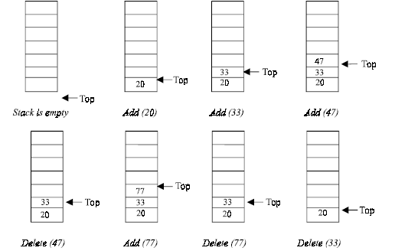
The operation of the stack

Slide 7
The operation of the stack…..cont
The insertion (or addition) operation is referred to as push
deletion (or remove) operation as pop.
A stack is said to be empty or underflow, if the stack contains no elements.
  At this point the top of the stack is present at the bottom of the stack.
It is overflow when the stack becomes full, i.e., no other elements can be pushed onto the stack.
  At this point the top pointer is at the highest location of the stack.

Slide 8
OPERATIONS PERFORMED ON STACK
The primitive operations performed on the stack are as follows:
  PUSH
  POP
  PUSH: The process of adding (or inserting) a new element to the top of the stack is called PUSH operation.
    Pushing an element to a stack will add the new element at the top.
    After every push operation the top is incremented by one.
    If the array is full and there is no new element can be accommodated, then the stack overflow condition occurs.

Slide 9
OPERATIONS PERFORMED ON STACK
  POP: The process of deleting (or removing) an element from the top of stack is called POP operation.
    After every pop operation the stack is decremented by one.
    If there is no element in the stack and the pop operation is performed then the stack underflow condition occurs.

Slide 10
STACK IMPLEMENTATION
Stack can be implemented in two ways:
1. Static implementation (using arrays)
2. Dynamic implementation (using pointers)
Static implementation uses arrays to create stack.
It is a very simple technique but is not a flexible way.
  The size of the stack has to be declared during the program design, after that, the size cannot be varied (i.e., increased or decreased).
The above said limitations can be overcome by dynamically implementing (is also called linked list representation) the stack using pointers.

Slide 11
STACK USING ARRAYS
Algorithm for push
Suppose STACK[SIZE] is a one dimensional array for implementing the stack, which will hold the data items.
TOP is the pointer that points to the top most element of the stack. DATA is the data item to be pushed.
  1. If TOP = SIZE – 1, then:
  (a) Display “The stack is in overflow condition”
  (b) Exit
  2. TOP = TOP + 1
  3. STACK [TOP] = ITEM
  4. Exit

Slide 12
Implementation in C++
void STACK_ARRAY::push()
{
int item;
if (Top == MAXSIZE–1)
{
cout<<“\nThe Stack Is Full”;
getch();
}
else
{
cout<<“\nEnter The Element To Be Inserted = ”;
cin>>item;
stack[++Top]=item;
}
}
//if the top pointer already reached the maximum allowed size then
//we can say that the stack is full or overflow
//Otherwise an element can be added or inserted by
//incrementing the stack pointer Top as follows
// Remember here Top=-1;

Slide 13
STACK USING ARRAYS
Algorithm for pop
TOP is the pointer that points to the top most element of the stack.
DATA is the popped (or deleted) data item from the top of the stack.
  1. If TOP < 0, then
    (a) Display “The Stack is empty”
    (b) Exit
  2. Else remove the Top most element
  3. DATA = STACK[TOP]
  4. TOP = TOP – 1
  5. Exit

Slide 14
Implementation in C++
void STACK_ARRAY::pop()
{
int item;
if (Top == –1)
cout<<“\nThe Stack Is Empty”;
else
{
item=stack[Top--];
cout<<“\nThe Deleted Element Is = ”<<item;
}
}
//If the Top pointer points to NULL, then the stack is empty
//That is NO element is there to delete or pop
//Otherwise the top most element in the stack is poped or
//deleted by decrementing the Top pointer

Slide 15
The function to print all the existing elements in the stack
void STACK_ARRAY::traverse()
{
int i;
if (Top == -1)
cout<<“\nThe Stack is Empty”;
else
{
cout<<“\n\nThe Element(s) In The Stack(s) is/are...”;
for(i=Top; i>=0; i--)
cout<<“\n ”<<stack[i];
}
}

Slide 16
Implementation of Stack Using Linked List

Slide 17
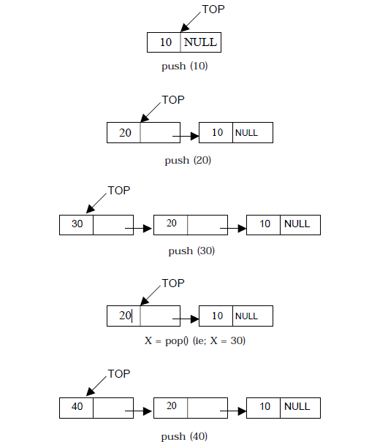
Implementation issues of the stack (Last In First Out - LIFO) using linked list

Slide 18
ALGORITHM FOR PUSH OPERATION
Suppose TOP is a pointer, which is pointing towards the topmost element of the stack. TOP is NULL when the stack is empty. DATA is the data item to be pushed.
1. Input the DATA to be pushed
2. Creat a New Node
3. NewNode → DATA = DATA
4. NewNode → Next = TOP
5. TOP = NewNode
6. Exit

Slide 19
LINKED STACK IMPLEMENTATION
class Stack_Linked
{
struct NODE //Structure is created for the node
{
int info;
struct NODE *link; //A link to the next node
};
NODE *top; //A variable top is been declared for the structure
public:
Stack_Linked() //Constructer is defined for the class
{
top=NULL; //top pointer is initialized
}
void push();
void pop();
void display();
};

Slide 20
Function to perform the push operation
void Stack_Linked::push()
{//A new node is created dynamically
  NODE *NewNode
  NewNode=new NODE; // or NODE *NewNode = new NODE
  int pushed_item; ;
  cout<<“\nInput the new value to be pushed on the stack:”;
  cin>>pushed_item;
  NewNode->info=pushed_item;//Data is pushed to the stack
  NewNode->link=top;//Link pointer is set to the next node
  top=NewNode;//Top pointer is set
}

Slide 21
ALGORITHM FOR POP OPERATION
Suppose TOP is a pointer, which is pointing towards the topmost element of the stack.
TOP is NULL when the stack is empty.
TEMP is pointer variable to hold any nodes address.
DATA is the information on the node which is just deleted.
1. if (TOP is equal to NULL)
    (a) Display “The stack is empty”
2. Else
    (a) TEMP = TOP
    (b) Display “The popped element TOP → DATA”
    (c) TOP = TOP → Next
    (d) TEMP → Next = NULL
    (e) Free the TEMP node
3. Exit

Slide 22
Function to implement the pop operation
void Stack_Linked::pop()
{
  NODE tmp;
  if(top == NULL) //checking whether the stack is empty or not
    cout<<“\nStack is empty\n”;
  else
{
tmp=top; //popping the element
cout<<“\nPopped item is:”<<tmp->info;
top=top->link; //resetting the top pointer
tmp->link=NULL;
delete(tmp); //freeing the popped node
}
}

Slide 23
Function to display all the element in the stack
void Stack_Linked::display()
{
  if(top==NULL) /Checking whether the stack is empty or not
  cout<<“\nStack is empty\n”;
    else
    {
    NODE ptr=top;
    cout<<“\nStack elements:\n”;
      while(ptr != NULL)
      {
      cout<<“\n”<<ptr->info;
      ptr = ptr->link;
      } /*End of while */
    } /*End of else*/
} /*End of display()*/

Slide 24
APPLICATIONS OF STACKS
There are a number of applications of stacks.
  Recursion
  String Reversing
  Checking for balanced braces
  Checking for Palindrome
  Memory Management
  Expression Evaluation

Slide 25
RECURSION
Recursion occurs when a function is called by itself repeatedly.
The general algorithm model for any recursive function contains the following steps:
  1. Prologue: Save the parameters, local variables, and return address.
  2. Body: If the base criterion has been reached, then perform the final computation
  and go to step 3; otherwise, perform the partial computation and go to step 1
  (initiate a recursive call).
  3. Epilogue: Restore the most recently saved parameters, local variables, and return address.
The key box in the flowchart contained in the body of the function is the one, which invokes a call to itself.
Each time a function call to itself is executed, the prologue of the function saves necessary information required for its proper functioning.

Slide 26
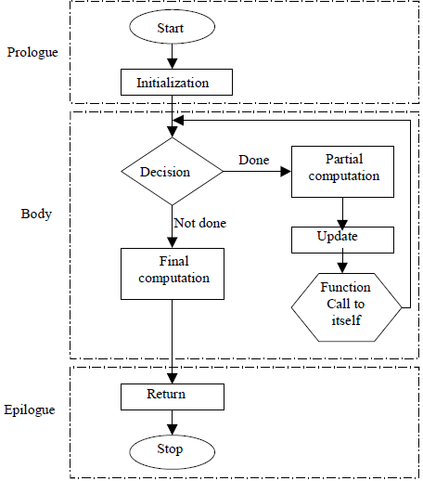
Flowchart model for a recursive algorithm

Slide 27
RECURSION
The Last-in-First-Out characteristics of a recursive function points that the stack is the most obvious data structure to implement the recursive function.
Programs compiled, make use of a stack for the procedure or function invocation in memory.
When any procedure or function is called, a number of words (such as variables, return address and other arguments and its data(s) for future use) are pushed
onto the program stack.
When the procedure or function returns, this frame of data is popped off the stack.
As a function calls a function, its arguments, return address and local variables are pushed onto the stack.

Slide 28
The stack is a region of main memory within which programs temporarily store data as they execute.
For example:
  When a program sends parameters to a function, the parameters are placed on the stack.
  When the function completes its execution these parameters are popped off from the stack.
  When a function calls other function the current contents (ie., variables) of the caller function are pushed onto the stack with the address of the instruction just next to the call instruction.
  This is done so after the execution of called function, the compiler can backtrack (or remember) the path from where it is sent to the called function.

Slide 29
String Reversing
Push each character on to a stack as it is read
When the line is finished, we then pop characters off the stack, and they will come off in the reverse order

Slide 30
Checking for Balanced Braces
A stack can be used to verify whether a program contains balanced braces
  An example of balanced braces
    abc{defg{ijk}{l{mn}}op}qr
  An example of unbalanced braces
    abc{def}}{ghij{kl}m

Slide 31
Checking for Balanced Braces
Requirements for balanced braces
  Each time you encounter a “}”, it matches an already encountered “{”
  When you reach the end of the string, you have matched each “{”

Slide 32
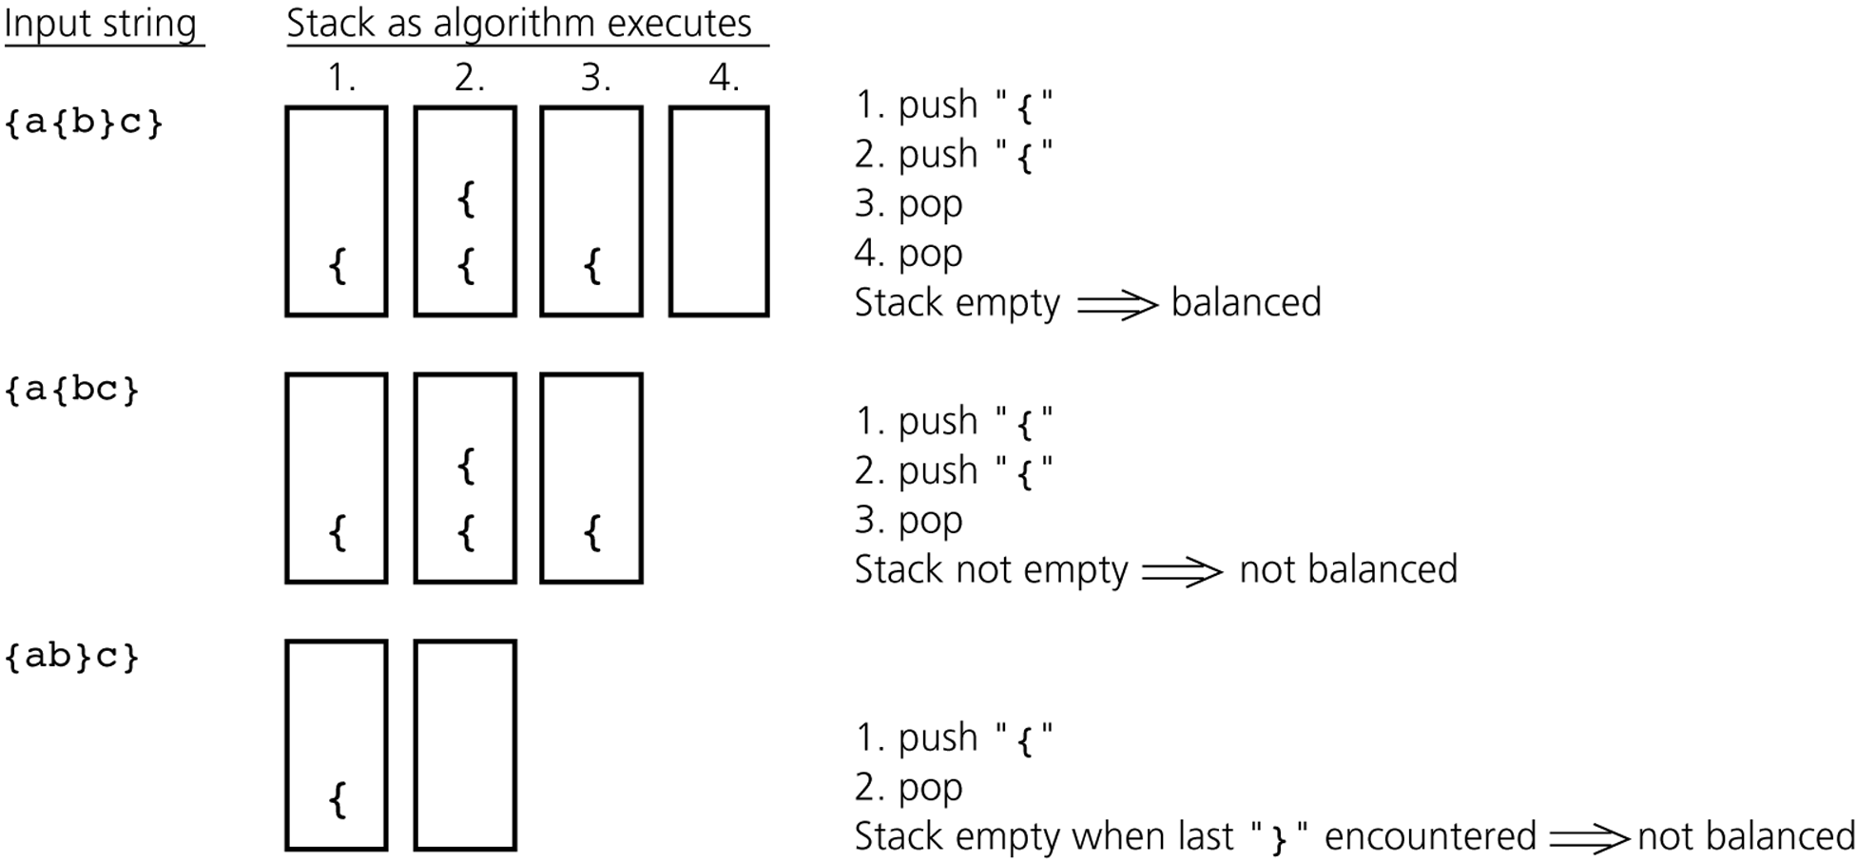
2. Checking for Balanced Braces

Slide 33
Palindrome
A Palindrome is a string that reads the same in either direction
  Examples: MALAYALAM
  Algorithm
  Scan the input string from left to right and push each character of input string onto a stack
  Form the reverse of the string by popping the characters and joining them together in the order that they come off the stack
  Compare the reversed string with the original. If they are the same, the original input string is a palindrome

Slide 34
A Legend: The Towers of Hanoi
In the great temple of Brahma in Benares, on a brass plate under the dome that marks the center of the world, there are 64 disks of pure gold that the priests carry one at a time between these diamond needles according to Brahma's immutable law: No disk may be placed on a smaller disk. In the begging of the world all 64 disks formed the Tower of Brahma on one needle. Now, however, the process of transfer of the tower from one needle to another is in mid course. When the last disk is finally in place, once again forming the Tower of Brahma but on a different needle, then will come the end of the world and all will turn to dust.

Slide 35

The Towers of Hanoi
A Stack-based Application
  GIVEN: three poles
  a set of discs on the first pole, discs of different sizes, the smallest discs at the top
  GOAL: move all the discs from the left pole to the right one.
  CONDITIONS: only one disc may be moved at a time.
  A disc can be placed either on an empty pole or on top of a larger disc.

Slide 36
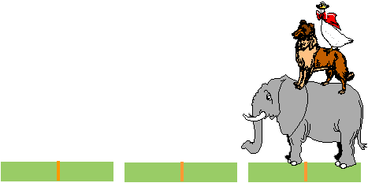
Towers of Hanoi

Slide 37
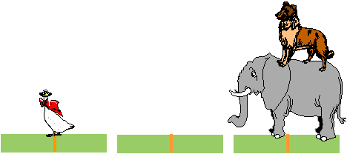
Towers of Hanoi

Slide 38
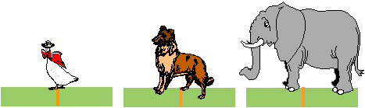
Towers of Hanoi

Slide 39

Towers of Hanoi

Slide 40

Towers of Hanoi

Slide 41

Towers of Hanoi

Slide 42
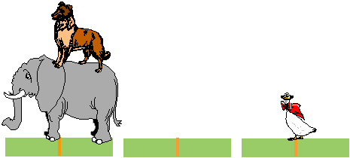
Towers of Hanoi

Slide 43
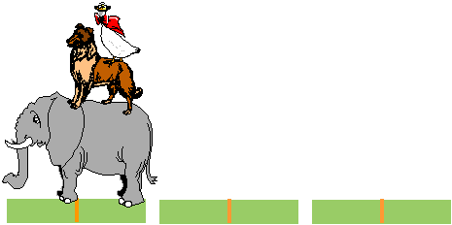
Towers of Hanoi

Slide 44
Expression Evaluation

Slide 45
Consider the same problems
Convert an infix expression into postfix expression. i.e.
  How a+b can be converted into ab+
And many more problems……..

Slide 46
EXPRESSION
An expression is defined as the number of operands or data items combined with several operators
There are basically three types of notation for an expression (mathematical expression.)
  1. Infix notation
  2. Prefix notation
  3. Postfix notation
The infix notation is, where the operator is written in-between the operands.
For example : The expression to add two numbers A and B is written in infix notation as:
A + B
The prefix notation is a notation in which the operator(s) is written before the operands, it is also called polish notation in the honor of the polish mathematician Jan Lukasiewicz who developed this notation.

Slide 47
EXPRESSION….cont
The same expression when written in prefix notation looks like:
+ A B
In the postfix notation the operator(s) are written after the operands, so it is called the postfix notation, it is also known as suffix notation or reverse polish notation.
A B +
For example, a C function to return the sum of two variables A and B (passed as argument) is called or invoked by the instruction:
add(A, B)
Note that the operator add (name of the function) precedes the operands A and B.
Moreover the postfix notation is the way computer looks towards arithmetic expression, any expression entered into the computer is first converted into postfix notation, stored in stack and then calculated.
In a postfix expression operands appear before the operator,so there is no need for operator precedence and other rules.

Slide 48
Converting Infix expression to postfix
When an operand is read, it is immediately placed onto the output
When an operator or left parenthesis comes then save it in the stack initially stack is empty
If we see a right parenthesis, then we pop the stack, writing symbols until we encounter a (corresponding) left parenthesis, which is popped but not output
If we see any other symbol (‘+’, ‘*’, ‘(‘, etc) then we pop entries form the stack until we find an entry of lower priority. One exception is that we never remove a ‘(‘ from the stack except when processing a ‘)’
When the popping is done, we push the operand onto the stack
Finally, if we read the end of input, we pop the stack until it is empty, writing symbols onto the output

Slide 49
Converting Infix expression to postfix
Convert the following infix expression to postfix expression
a+b*c+(d*e+f)*g
First the symbol a is read, so it is passed through to the output
a
Then + is read and pushed onto the stack
output
+
stack
Next b is read and passed through to the output
ab
output
*
+
Next a * is read. The top entry on the operator stack has lower precedence than *, so nothing is output and * is put on the stack
stack

Slide 50
Converting Infix expression to postfix
Converting the following infix expression to postfix expression
a+b*c+(d*e+f)*g
Next c is read and output
abc
output
The next symbol is a +. Checking the stack, we find that priority of stack top symbol * is higher than + . So we pop a * and place it on the output, Pop the other +, which is not of lower but equal priority, and then push +
*
+
abc*+
+
output
stack
stack

Slide 51
Converting Infix expression to postfix
Converting the following infix expression to postfix expression
a+b*c+(d*e+f)*g
The next symbol read is ‘(‘, which, being of highest precedence, is placed on the stack
(
+
stack
Then d is read and output
abc*+d
output

Slide 52
Converting Infix expression to postfix
Converting the following infix expression to postfix expression.
a+b*c+(d*e+f)*g
We continue by reading a *. Since open parenthesis do not get removed except when a closed parenthesis is being processed, there is no output and we push * in stack
*
(
+
stack
Next, e is read and output is
abc*+de
output

Slide 53
Converting Infix expression to postfix
Converting the following infix expression to postfix expression.
a+b*c+(d*e+f)*g
The next symbol read is a +, since priority of stack top value is higher so we pop * and push +
+
(
+
abc*+de*
output
stack
Now we read f and output f
abc*+de*f
output

Slide 54
Converting Infix expression to postfix
Converting the following infix expression to postfix expression.
a+b*c+(d*e+f)*g
Now we read a ‘)’, so the stack is emptied back to the ‘(‘, we output a +
abc*+de*f+
+
output
stack
*
+
We read a * next; it is pushed onto the stack
stack
abc*+de*f+g
Now, g is read and output
output

Slide 55
Converting Infix expression to postfix
Converting the following infix expression to postfix expression.
a+b*c+(d*e+f)*g
*
+
stack
The input is now empty, so pop output symbols from the stack until it is empty
abc*+de*f+g*+
output
stack

Slide 56
Consider the same problems
Evaluate a postfix expression / postfix calculator.
  A postfix expression is a mathematical expression in which operators appears at the right side of an operand. E.g.
  ab+ is equivalent to a+b,
  ab+c- is equivalent to a+b-c
  ab+cd*- is equivalent to a+b-c*d

Slide 57
Evaluating Postfix Expression
Postfix Expression Evaluation
  When a number is seen, it is pushed onto the stack
  When an operator is seen, then pop two elements from stack and push the result onto the stack
Now we evaluate the following postfix expression
6 5 2 3 + 8 * + 3 + *
3
2
5
6
The first four are placed on the stack. The resulting stack is
stack

Slide 58
Evaluating Postfix Expression
evaluating the following postfix expression.
6 5 2 3 + 8 * + 3 + *
3
2
5
6
stack
5
5
6
Next a + is read, so 3 and 2 are popped from the stack and
their sum 5 is pushed
stack

Slide 59
Evaluating Postfix Expression
evaluating the following postfix expression.
6 5 2 3 + 8 * + 3 + *
5
5
6
stack
8
5
5
6
Next 8 is read and pushed
stack

Slide 60
Evaluating Postfix Expression
evaluating the following postfix expression.
6 5 2 3 + 8 * + 3 + *
8
5
5
6
stack
40
5
6
Next a * is seen so 8 and 5 are popped as 8 * 5 = 40 is pushed
stack

Slide 61
Evaluating Postfix Expression
evaluating the following postfix expression.
6 5 2 3 + 8 * + 3 + *
40
5
6
stack
Next a + is read so 40 and 5 are popped and 40 + 5 = 45 is pushed
45
6
stack

Slide 62
Evaluating Postfix Expression
evaluating the following postfix expression.
6 5 2 3 + 8 * + 3 + *
45
6
stack
3
45
6
Now 3 is pushed
stack

Slide 63
Evaluating Postfix Expression
evaluating the following postfix expression.
6 5 2 3 + 8 * + 3 + *
3
45
6
stack
Next symbol is + so pops 3 and 45 and pushes 45 + 3 = 48,
so push 48 in stack
48
6
stack

Slide 64
Evaluating Postfix Expression
evaluating the following postfix expression.
6 5 2 3 + 8 * + 3 + *
48
6
stack
Finally a * is seen and 48 and 6 are popped, the result 6 * 48 = 288 is pushed
As there is no input, so pop the stack and we get the result
288
stack

Slide 65
Algorithm to Evaluate Postfix Expression
Input: A postfix expression
Output: The evaluated result
Create an empty stack
For each character char in expression, do:
  If char is a digit:
    Convert char to an integer and push it onto the stack
  Else if char is an operator:
    Pop operand2 from the stack
    Pop operand1 from the stack
    Perform the operation based on char:
      If char is '+': result = operand1 + operand2
      If char is '-': result = operand1 - operand2
      If char is '*': result = operand1 * operand2
      If char is '/': result = operand1 / operand2
    Push result back onto the stack
Return the top value from the stack (final result)

Slide 66
Implementation in C++
#include <iostream>
#include <stack>
using namespace std;
int evaluate(string str) {
stack<int> s; // Stack to store operands
for (int i = 0; i < str.size(); i++) {
char ch = str[i];
// If the character is a digit, push its integer value onto the stack
if (ch >= '0' && ch <= '9') {
s.push(ch - '0'); // Convert char to integer
}
// If the character is an operator, pop two operands and perform the operation
else if (ch == '+' || ch == '-' || ch == '*' || ch == '/') {
int first = s.top();
s.pop();
int second = s.top();
s.pop();
switch (ch) {
case '+': s.push(second + first); break;
case '-': s.push(second - first); break;
case '*': s.push(second * first); break;
case '/': s.push(second / first); break;
default: break;
}
}
}
return s.top(); // The final result is on top of the stack
}
int main() {
string expression = "562*+"; // Example postfix expression
cout << "Result: " << evaluate(expression) << endl;
return 0;
}

Slide 67
Why Do We Need ch - '0'?
In C++ (and many other languages), when we read characters from a string, they are treated as characters (not numbers).
Even though str[i] might visually look like a digit ('5', '6', etc.), it is stored as a character in memory.
Characters are stored using ASCII values:
  '0' in ASCII = 48
  '1' in ASCII = 49
  '2' in ASCII = 50...
  '9' in ASCII = 57
So, if you directly push ch into the stack without converting, you are pushing ASCII values instead of numbers.

Slide 68
Example With ch - '0'
Now, let's apply ch - '0'.
Step | Character | ASCII | ch - '0' | Stack
Push '5' | 53 | '5' - '0' = 5 | 53 – 48 = 5 | 5
Push '6' | 54 | '6' - '0' = 6 | 54 – 48 = 6 | 5 6
Push '2' | 50 | '2' - '0' = 2 | 50 – 48 = 2 | 5 6 2
Now, if we pop and perform multiplication:
first = 2
second = 6
second * first = 6 * 2 = 12 ✅ (Correct!)

